Slide 1
TOPIC 4:FILE AND DIRECTORY HANDLING 4.2 Understand Exception

Slide 2
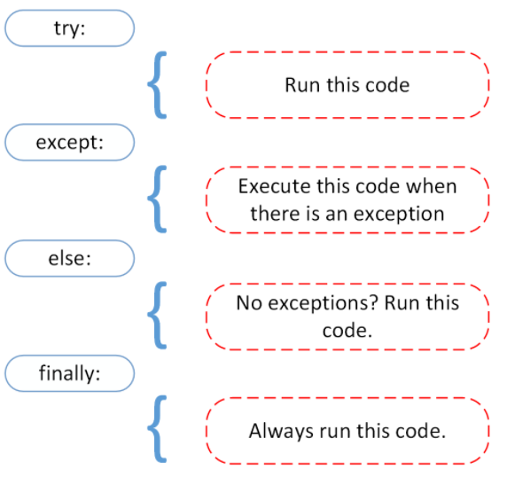
Exception Handling
Exception When an error occurs (in Python we call it exception), Python will normally stop and generate an error message.
These exceptions can be handled using

Slide 3


Syntax vs logical error (exception)
Syntax errors | Logical errors (Exceptions)
Syntax error n name error

Slide 4
Built-In Exception Classes
ArithmeticError – this is the base class for arithmetic errors.
AssertionError – raised when an assertion fails.
AttributeError – when the attribute is not found.
BufferError
EOFError – reading after end of file
ImportError – when the imported module is not found.
LookupError – base exception for lookup errors.
MemoryError – when out of memory occurs
NameError – when a name is not found globally.
OSError – base class for I/O errors
ReferenceError
RuntimeError
StopIteration, StopAsyncIteration
SyntaxError – invalid syntax
SystemError – internal error in the Python Interpreter.
TypeError – invalid argument type
ValueError – invalid argument value

Slide 5
Built-In Warning Classes
BytesWarning – bytes, and buffer related warnings, mostly related to string conversion and comparison.
DeprecationWarning – warning about deprecated features
FutureWarning – base class for warning about constructs that will change semantically in the future.
ImportWarning – warning about mistakes in module imports
PendingDeprecationWarning – warning about features that will be deprecated in future.
ResourceWarning – resource usage warnings
RuntimeWarning – warnings about dubious runtime behavior.
SyntaxWarning – warning about dubious syntax
UnicodeWarning – Unicode conversion-related warnings
UserWarning – warnings generated by the user code

Slide 6
Handling Multiple Exceptions in a Single Except Block
Multiple Exceptions | Single Except
def divide(x, y): try: print(f'{x}/{y} is {x / y}') except ZeroDivisionError as e: print(e) except TypeError as e: print(e) except ValueError as e: print(e) | def divide(x, y): try: print(f'{x}/{y} is {x / y}') except (ZeroDivisionError, TypeError, ValueError) as e: print(e)

Slide 7
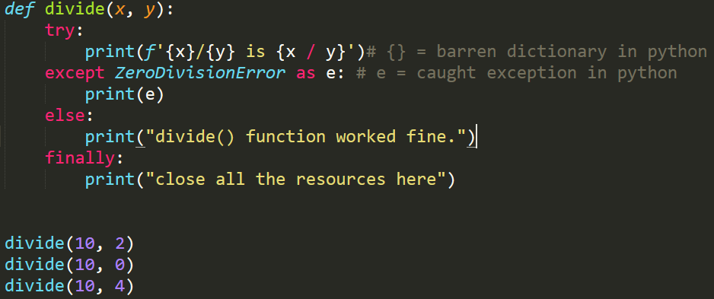
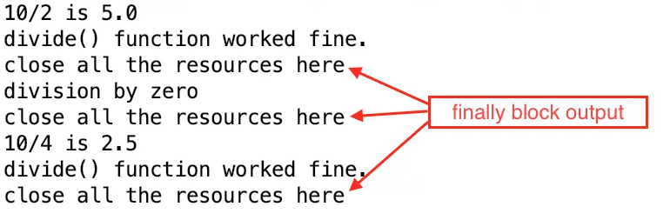
Finally block code
Finally is executed in all the cases, whether there is an exception or not. The finally block is used to close resources and perform clean-up activities. Code: Output:

Slide 8
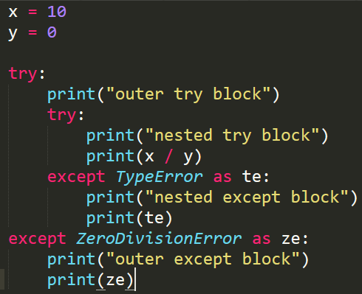
Nested try-except Blocks Example
In this case, if an exception is raised in the nested try block, the nested except block is used to handle it. In case the nested except is not able to handle it, the outer except blocks are used to handle the exception. Example

Slide 9
Raising Exceptions
Raise is Triggers an exception manually using custom exceptions
Use raise keyword to throw an exception from our code. Some of the possible scenarios are:
Function input parameters validation fails
Catching an exception and then throwing a custom exception
Use syntax:
raise Exception()
Note: The raise keyword is used to raise an exception.

Slide 10
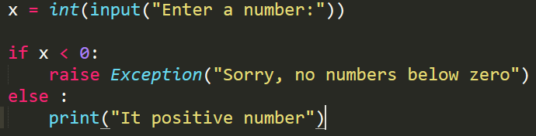

Example of raise Exception
Raise an error and stop the program if x is lower than 0:
Output if user input negative number:

Slide 11
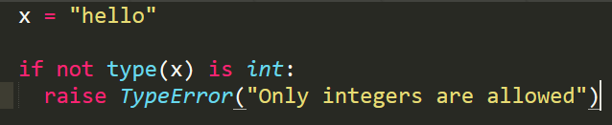

Example of raise TypeError
Raise a TypeError if x is not an integer:
Output if user input not an integer:

Slide 12
Thanks!

